Slide 1
Predator-prey systems
Group: Amalia Bogri, Christian Berrig & Jonas Bolduan

Slide 2
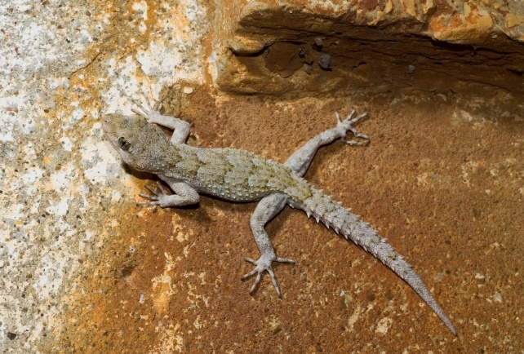
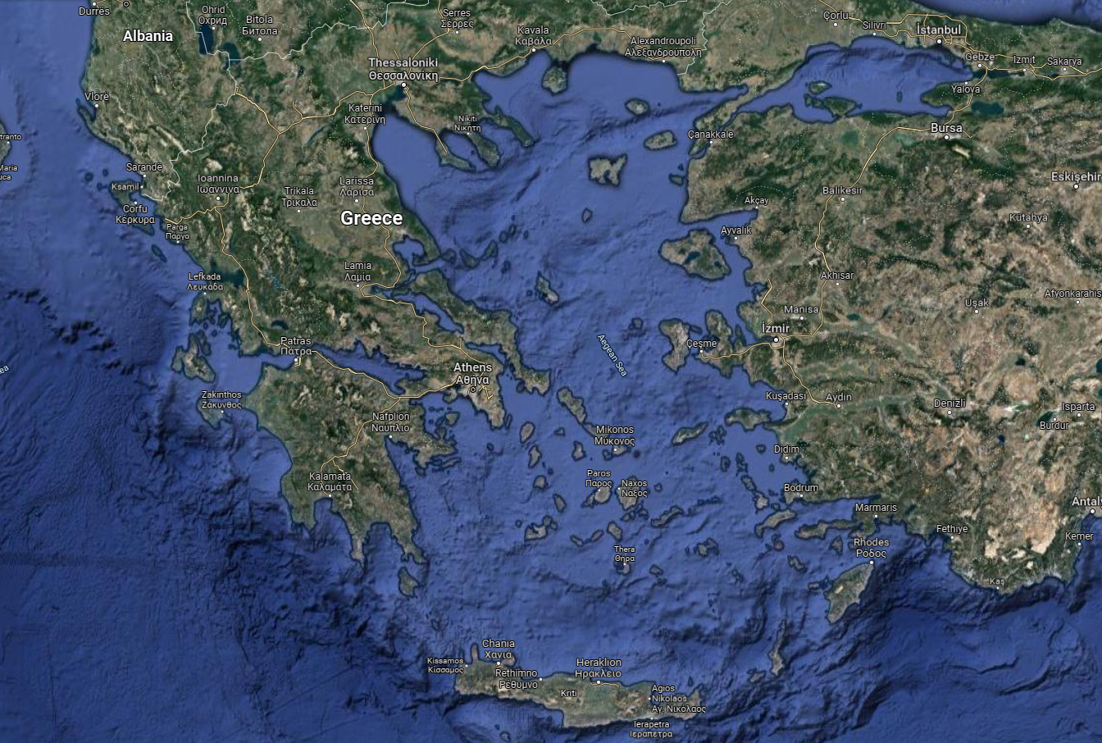
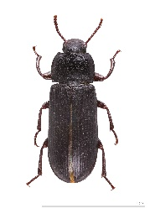
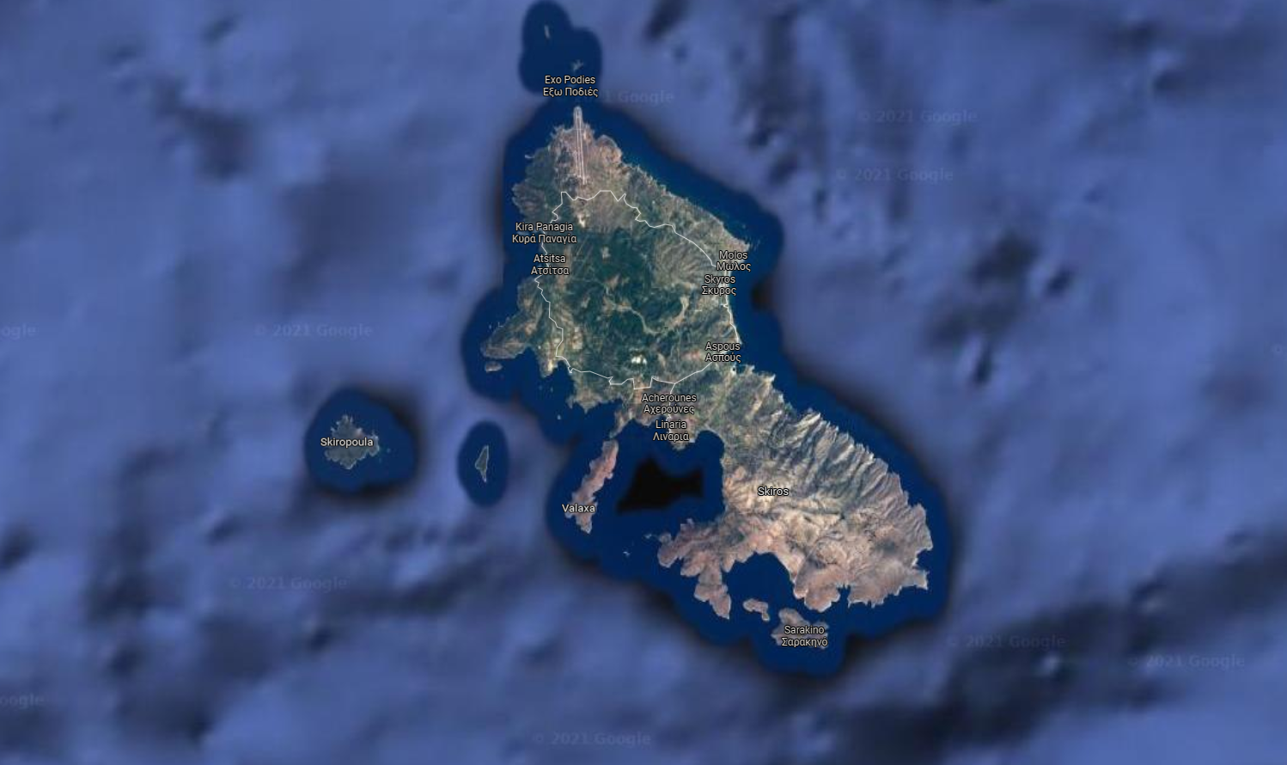
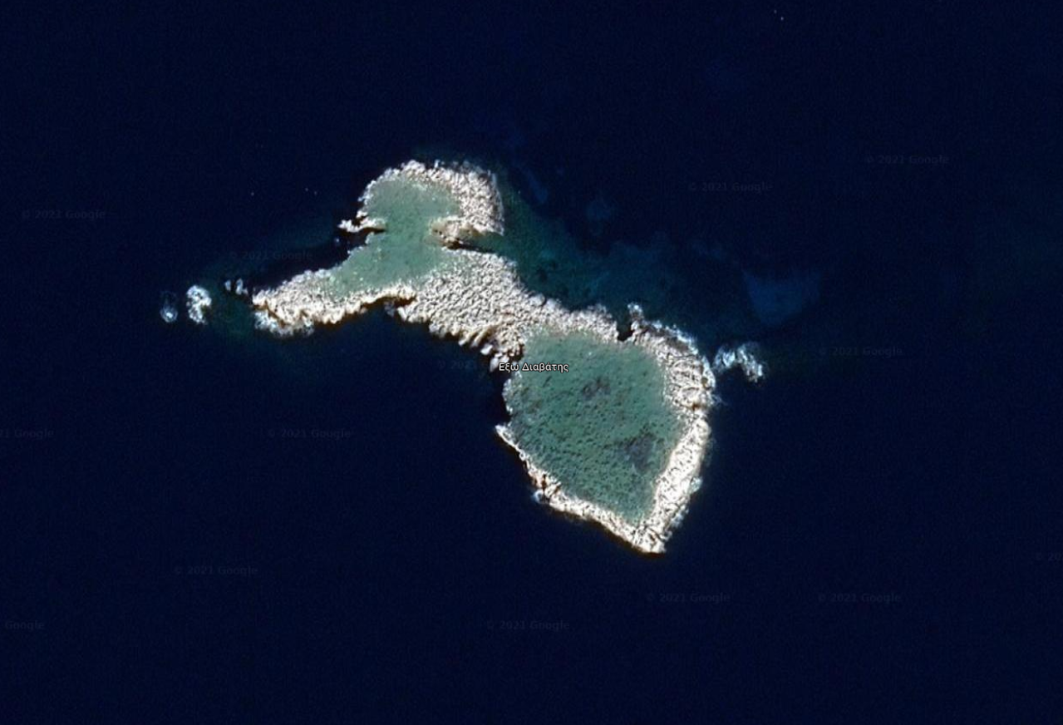
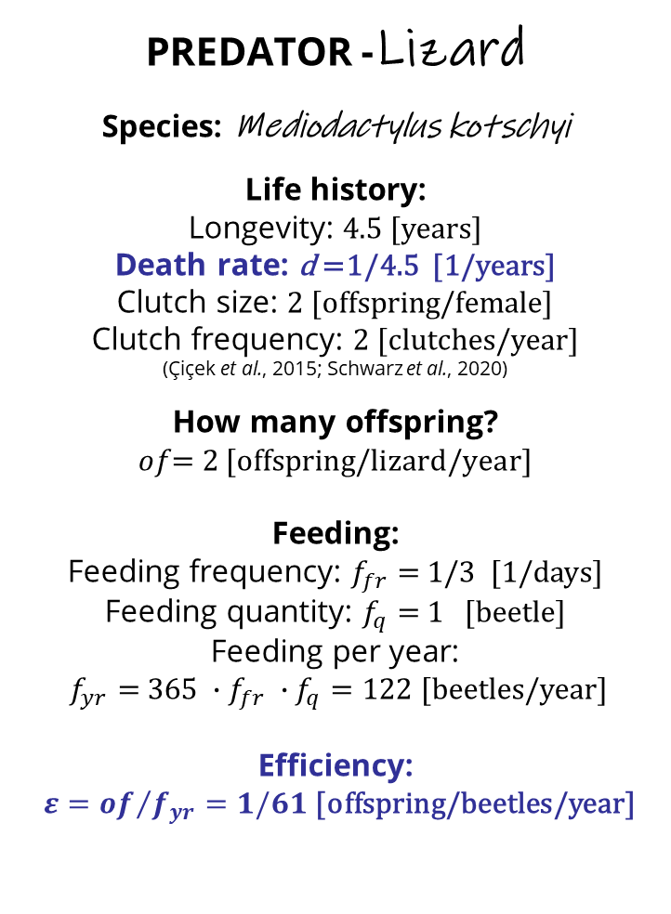
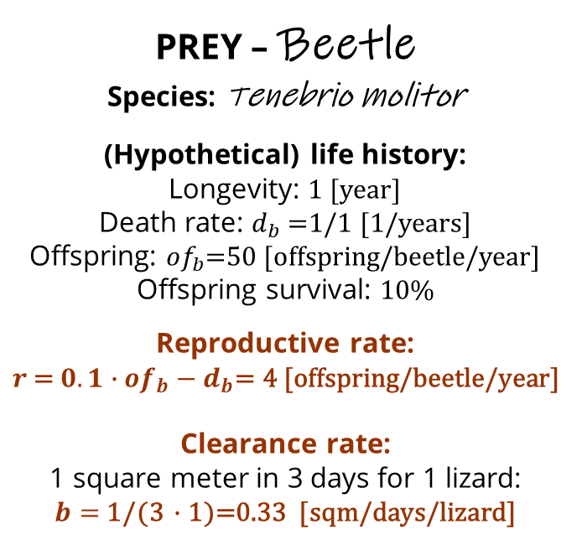
The case: insular geckos on an Aegean islet
LOCATION:
Exo Diavates, V = 20 [sqm]
PREDATOR -Lizard
Species: Mediodactylus kotschyi
Life history:
Longevity: 4.5 [years]
Death rate: d =1/4.5 [1/years]
Clutch size: 2 [offspring/female]
Clutch frequency: 2 [clutches/year]
(Çiçek et al., 2015; Schwarz et al., 2020)
How many offspring?
$$of\text{= }\text{2 [}\text{offspring}\text{/}\text{lizard}\text{/}\text{year}\text{]}$$
Feeding:
Feeding frequency: $f_{fr}=$ 1/3 [1/days]
Feeding quantity: $f_{q}=$ 1 [beetle]
Feeding per year:
$f_{yr}=$ ${{365 ∙f}_{fr} ∙f}_{q}=122$[beetles/year]
Efficiency:
${ε=of}/{f_{yr}}=1/61$ [offspring/beetles/year]
PREY – Beetle
Species: Tenebrio molitor
(Hypothetical) life history:
Longevity: 1 [year]
Death rate: $d_{b}$=1/1 [1/years]
Offspring: ${of}_{b}$=50 [offspring/beetle/year]
Offspring survival: 10%
Reproductive rate:
$$r \text{=}{ 0.1∙of}_{b}−d_{b}\text{= 4}\text{ [}\text{offspring}\text{/}\text{beetle}\text{/}\text{year}\text{]}$$
Clearance rate:
1 square meter in 3 days for 1 lizard:
$b=$ 1/(3 $∙$1)=0.33 [sqm/days/lizard]
© Benny Trapp,
CC BY 3.0
<https://creativecommons.org/licenses/by/3.0>,
via Wikimedia Commons
2

Slide 3
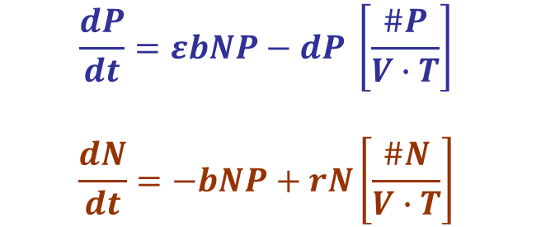
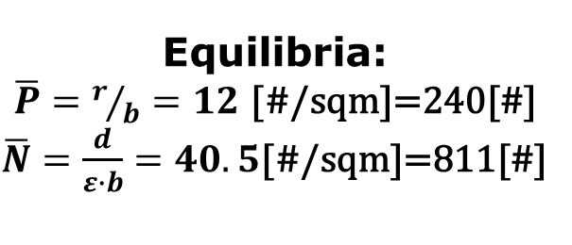
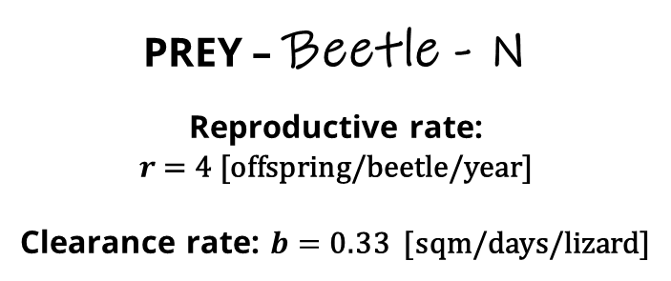
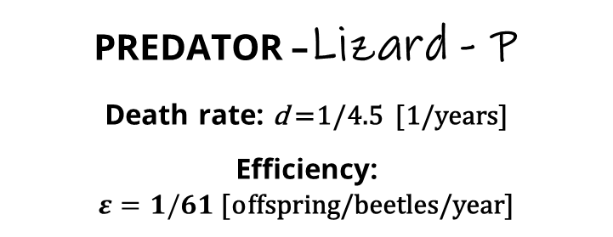
Lotka-Volterra Predator-Prey equations
PREDATOR –Lizard - P
Death rate: d =1/4.5 [1/years]
Efficiency:
$ε=1/61$ [offspring/beetles/year]
εbNP
N
P
𝑑P
r
PREY – Beetle - N
Reproductive rate:
$$r \text{= 4}\text{ [}\text{offspring}\text{/}\text{beetle}\text{/}\text{year}\text{]}$$
Clearance rate: $b=$ 0.33 [sqm/days/lizard]
$$\frac{dP}{dt}=εbNP−dP \left[\frac{\#P}{V∙T}\right]$$
$$\frac{dN}{dt}=−bNP+rN\left[\frac{\#N}{V∙T}\right]$$
Equilibria:
$\overline{P}=r/b=12$ [#/sqm]=240[#]
$\overline{N}=\frac{d}{ε∙b}=40.5$[#/sqm]=811[#]
© Benny Trapp,
CC BY 3.0
<https://creativecommons.org/licenses/by/3.0>,
via Wikimedia Commons
LOCATION:
V = 20 [sqm]
3

Slide 4
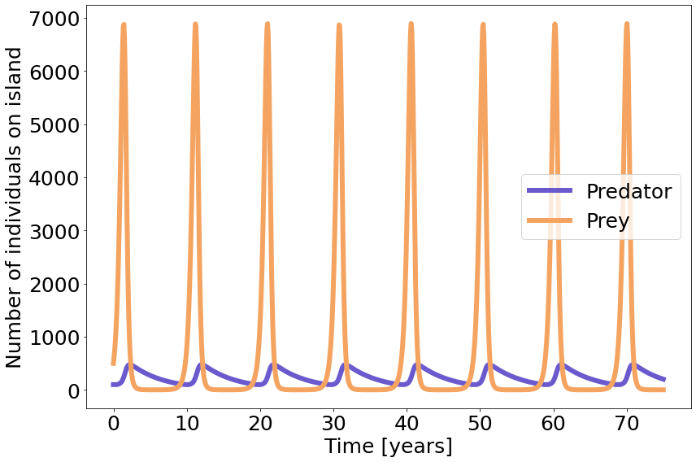
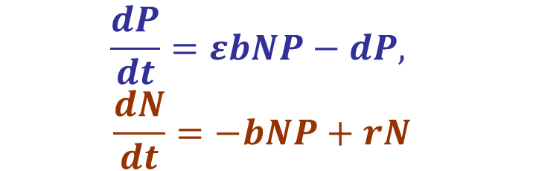

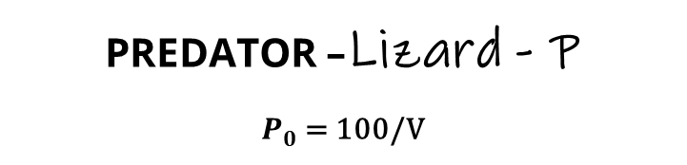
Lotka-Volterra Predator-Prey, plot in time (75 years)
PREDATOR –Lizard - P
$P_{0}$ = 100/V
PREY – Beetle - N
$N_{0}$ = 500/V
LOCATION:
V = 20 [sqm]
$$\frac{dP}{dt}=εbNP−dP,$$
$$\frac{dN}{dt}=−bNP+rN$$
© Benny Trapp,
CC BY 3.0
<https://creativecommons.org/licenses/by/3.0>,
via Wikimedia Commons
4

Slide 5
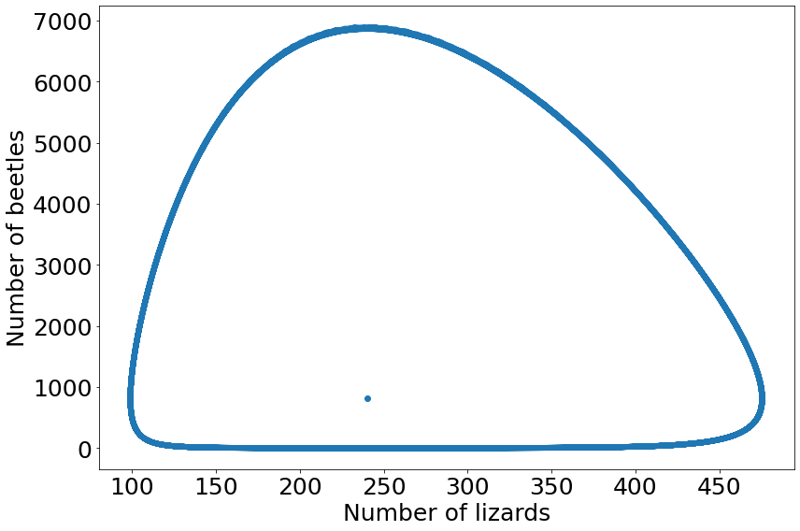
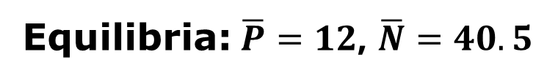
Lotka-Volterra Predator-Prey, phase plane plot
PREDATOR –Lizard - P
$P_{0}$ = 100/V
PREY – Beetle - N
$N_{0}$ = 500/V
LOCATION:
V = 20 [sqm]
$$\frac{dP}{dt}=εbNP−dP,$$
$$\frac{dN}{dt}=−bNP+rN$$
© Benny Trapp,
CC BY 3.0
<https://creativecommons.org/licenses/by/3.0>,
via Wikimedia Commons
Equilibria:$\overline{P}=12$, $\overline{N}=40.5$
5

Slide 6
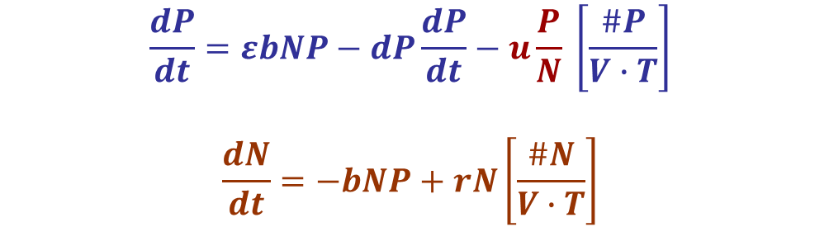
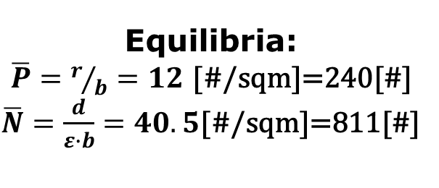
Lotka-Volterra Predator-Prey: Mortality due to hunger
εbNP
N
P
𝑑P
r
uP/N
$$\frac{dP}{dt}=εbNP−dP\frac{dP}{dt}−u\frac{P}{N} \left[\frac{\#P}{V∙T}\right]$$
$$\frac{dN}{dt}=−bNP+rN\left[\frac{\#N}{V∙T}\right]$$
Equilibria:
$\overline{P}=r/b=12$ [#/sqm]=240[#]
$\overline{N}=\frac{d}{ε∙b}=40.5$[#/sqm]=811[#]
© Benny Trapp,
CC BY 3.0
<https://creativecommons.org/licenses/by/3.0>,
via Wikimedia Commons
6

Slide 7
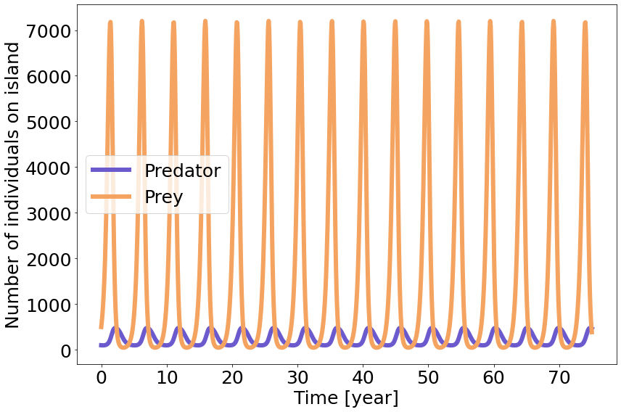
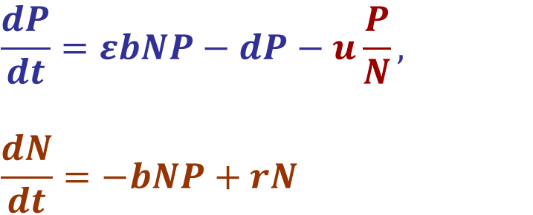
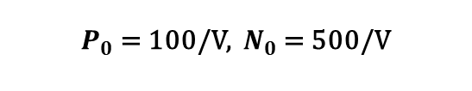
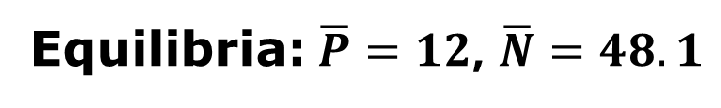
Lotka-Volterra Predator-Prey: Mortality due to hunger
$P_{0}$ = 100/V, $N_{0}$ = 500/V
$$\frac{dP}{dt}=εbNP−dP−u\frac{P}{N},$$
$$\frac{dN}{dt}=−bNP+rN$$
© Benny Trapp,
CC BY 3.0
<https://creativecommons.org/licenses/by/3.0>,
via Wikimedia Commons
Equilibria:$\overline{P}=12$, $\overline{N}=48.1$
7

Slide 8
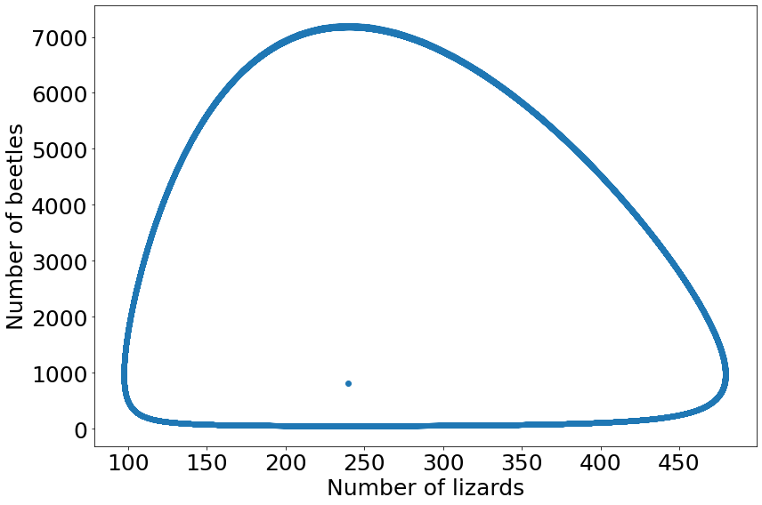
Lotka-Volterra Predator-Prey: Mortality due to hunger
$P_{0}$ = 100/V, $N_{0}$ = 500/V
WE DO NOT HAVE THE CORRECT EQUILIBRIUM PLOTTED!!
$$\frac{dP}{dt}=εbNP−dP−u\frac{P}{N},$$
$$\frac{dN}{dt}=−bNP+rN$$
© Benny Trapp,
CC BY 3.0
<https://creativecommons.org/licenses/by/3.0>,
via Wikimedia Commons
Equilibria:$\overline{P}=12$, $\overline{N}=48.1$
8

Slide 9
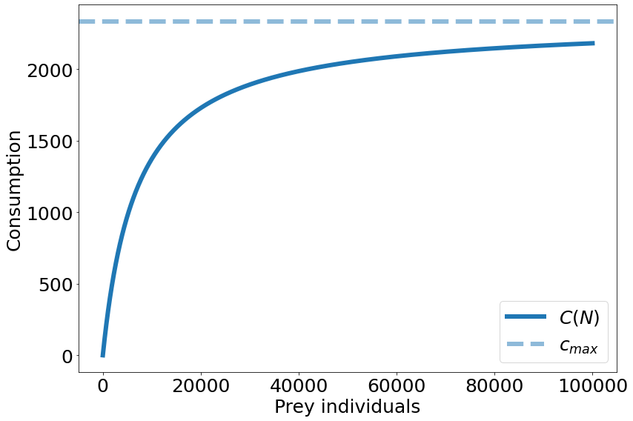
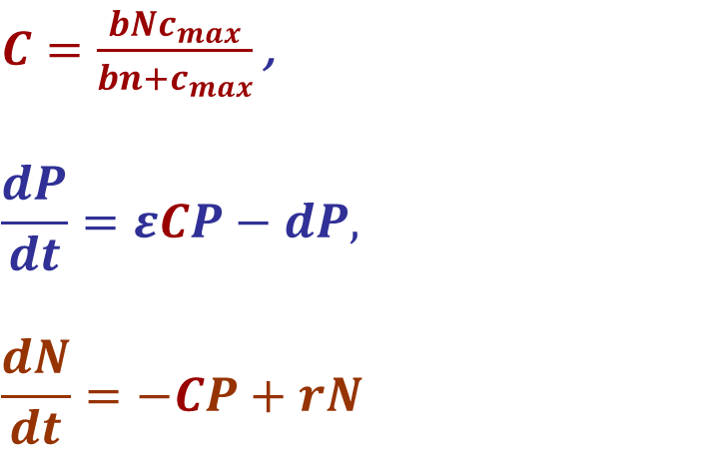
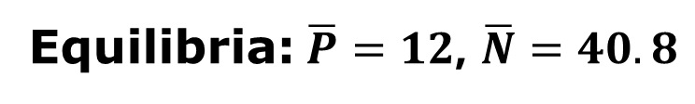
Lotka-Volterra Predator-Prey: Type II functional response
$P_{0}$ = 100/V, $N_{0}$ = 500/V
$C=\frac{bNc_{max}}{bn+c_{max}}$ ,
$$\frac{dP}{dt}=εCP−dP,$$
$$\frac{dN}{dt}=−CP+rN$$
© Benny Trapp,
CC BY 3.0
<https://creativecommons.org/licenses/by/3.0>,
via Wikimedia Commons
Equilibria:$\overline{P}=12$, $\overline{N}=40.8$
9

Slide 10
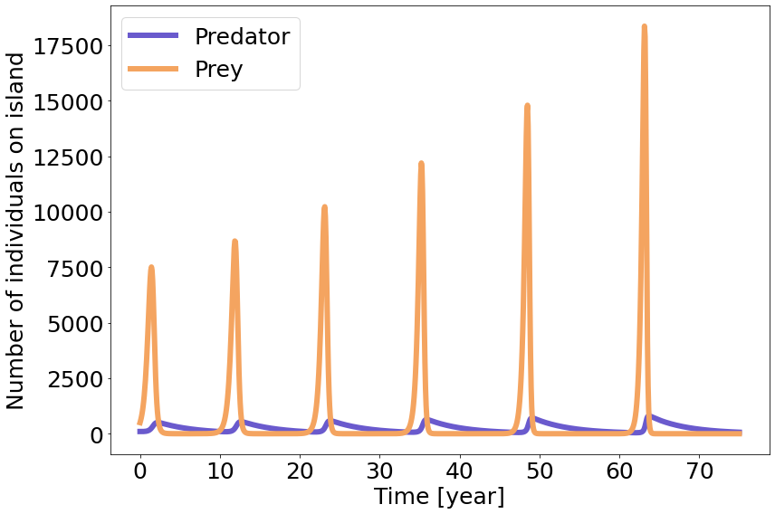
Lotka-Volterra Predator-Prey: Type II functional response
$P_{0}$ = 100/V, $N_{0}$ = 500/V
$C=\frac{bNc_{max}}{bn+c_{max}}$ ,
$$\frac{dP}{dt}=εCP−dP,$$
$$\frac{dN}{dt}=−CP+rN$$
© Benny Trapp,
CC BY 3.0
<https://creativecommons.org/licenses/by/3.0>,
via Wikimedia Commons
Equilibria:$\overline{P}=12$, $\overline{N}=40.8$
10

Slide 11
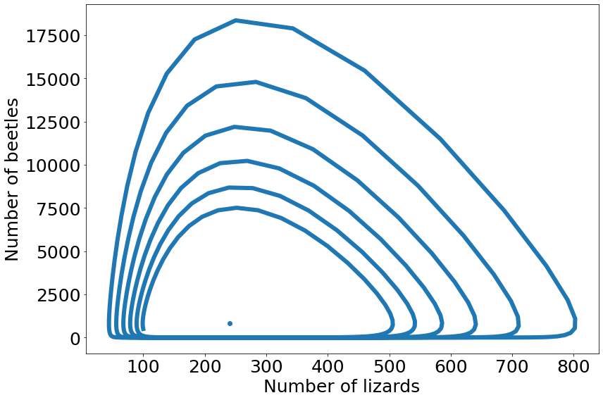
Lotka-Volterra Predator-Prey: Type II functional response
$P_{0}$ = 100/V, $N_{0}$ = 500/V
WE DO NOT HAVE THE CORRECT EQUILIBRIUM PLOTTED!!
$C=\frac{bNc_{max}}{bn+c_{max}}$ ,
$$\frac{dP}{dt}=εCP−dP,$$
$$\frac{dN}{dt}=−CP+rN$$
© Benny Trapp,
CC BY 3.0
<https://creativecommons.org/licenses/by/3.0>,
via Wikimedia Commons
Equilibria:$\overline{P}=12$, $\overline{N}=40.8$
11

Slide 12
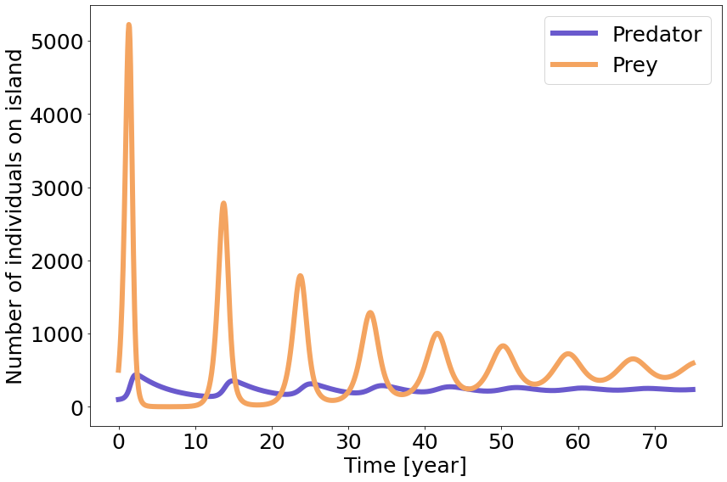
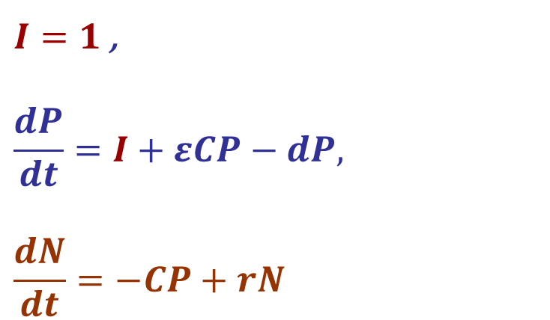
Lotka-Volterra Predator-Prey: Immigration of predators
$P_{0}$ = 100/V, $N_{0}$ = 500/V
$I=1$ ,
$$\frac{dP}{dt}=I+εCP−dP,$$
$$\frac{dN}{dt}=−CP+rN$$
© Benny Trapp,
CC BY 3.0
<https://creativecommons.org/licenses/by/3.0>,
via Wikimedia Commons
Equilibria:$\overline{P}=12$, $\overline{N}=40.8$
12

Slide 13
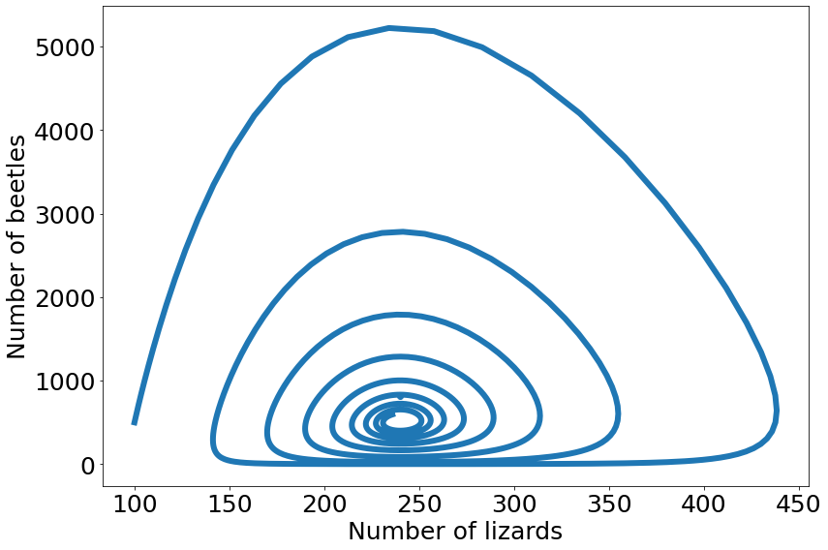
Lotka-Volterra Predator-Prey: Immigration of predators
$P_{0}$ = 100/V, $N_{0}$ = 500/V
WE DO NOT HAVE THE CORRECT EQUILIBRIUM PLOTTED!!
$I=1$ ,
$$\frac{dP}{dt}=I+εCP−dP,$$
$$\frac{dN}{dt}=−CP+rN$$
© Benny Trapp,
CC BY 3.0
<https://creativecommons.org/licenses/by/3.0>,
via Wikimedia Commons
Equilibria:$\overline{P}=12$, $\overline{N}=40.8$
13

